Slide 1

Arduino for Neuroscientists NBHVGR7040
AfN #1: Introduction, Simple Inputs and Outputs

Slide 2


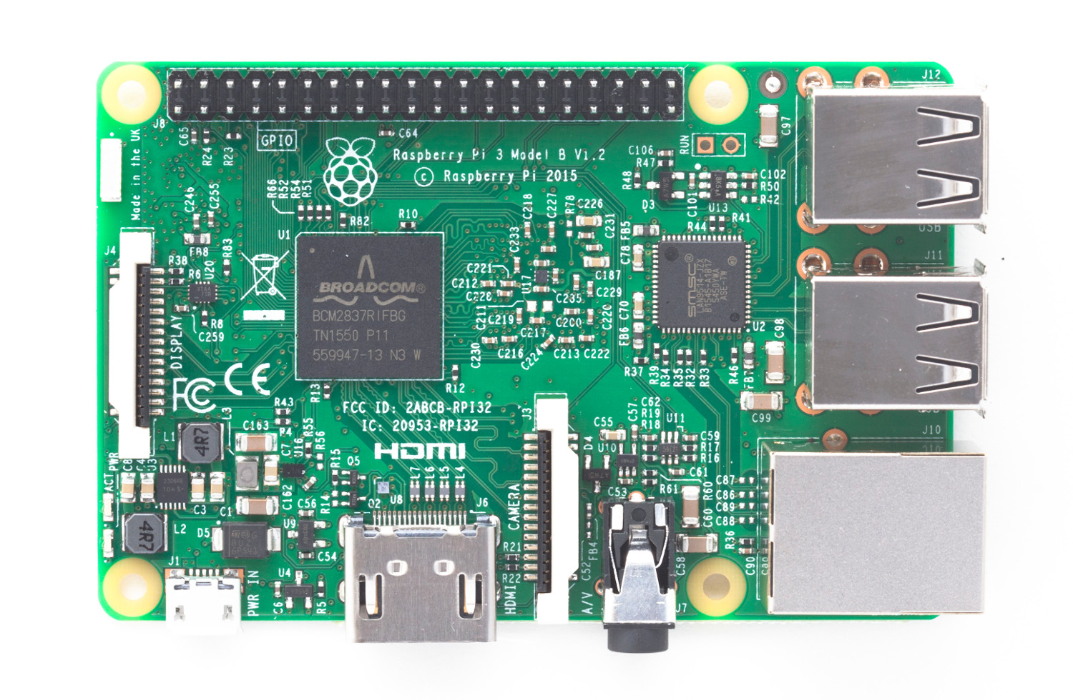

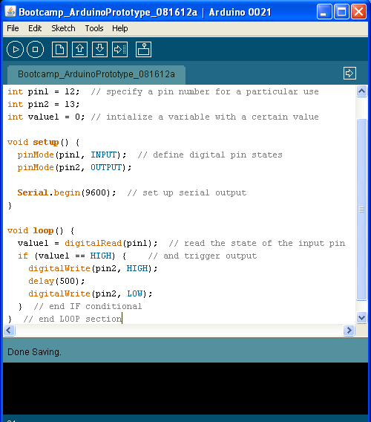

The World of Open Source Hardware and Software
Notes:
What is open-source? A design philosophy, first and foremost. Currently, there are a wealth of open-source tools available of potential benefit to a neuroscientist.

Slide 3
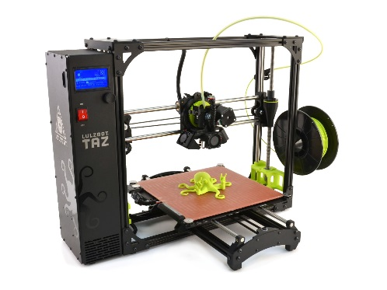
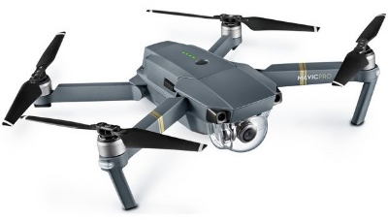

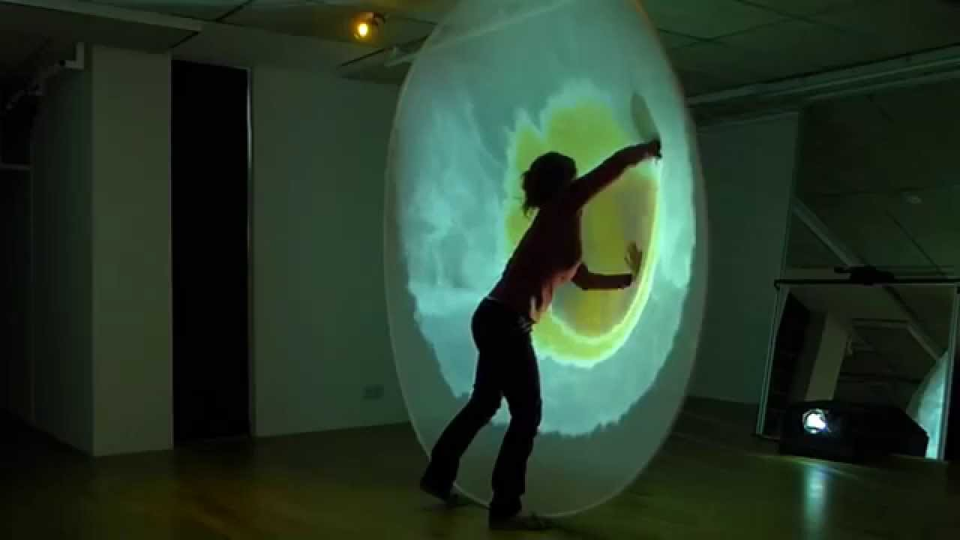
Uses of open-source hardware and software
3D printers / CNC
drones
Internet of things (IOT)
Interactive art

Slide 4


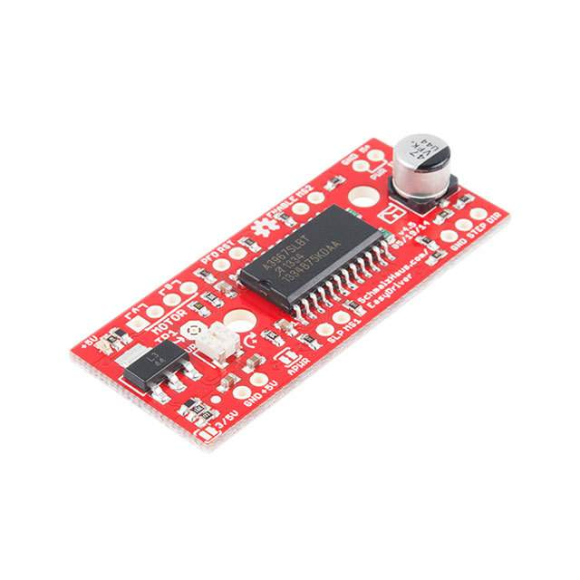
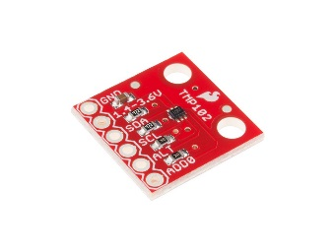
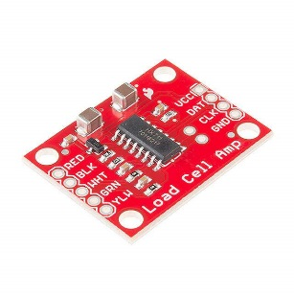


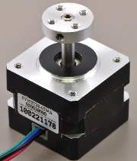

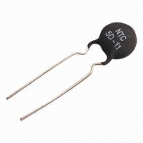
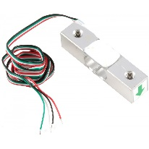


Hardware:
Microcontrollers (MCUs)
Processors that run simple programs to control inputs and outputs.
Arduino (and arduino clones)
Parallax
Single-board computers
Linux-based (or Win) systems that run on ARM processors
Good for things that require more processing power, memory,
Raspberry Pi, Beaglebone black
Electronics
sensors, motors, amplifiers, etc.
Notes:
Processing hardware such as microcontrollers and single-board computers allow a user to easily process and record diverse inputs derived from electronic circuits (e.g. sensors) and generate physical output. Electronic circuits act as sensory and motors systems, and the processing hardware acts as a central nervous system to let you change the logic of the sensory-motor transformation.

Slide 5
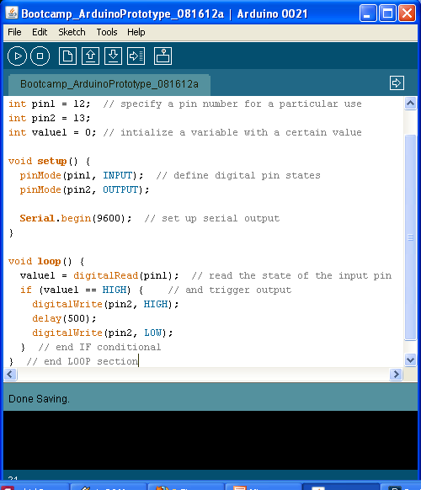
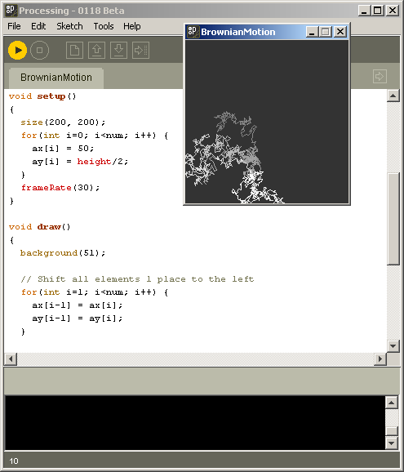

Software:
Software for controlling the hardware
Arduino
Python
Software for online processing/analysis
(or complex stimulus pres.)
Python
Processing.org
R
Octave (~open MATLAB)
Notes:
Open source software packages allow you to control hardware and record/process resulting data, and come with extensive communities of contributing users (if you ever have a problem, the odds are someone else has already encountered it, and solved it). Software defines the logic of the input-output transformation.

Slide 6
Why Arduino?
Pros
Fast and consistent input/output (like spinal cord)
Easy to program (free software IDE and USB connec.)
Easily interfaces with analog and digital circuits (and computers)
Large community support
Cheap (~$30)
Cons
Single-threaded
Limited bandwidth
No true analog output
+5V/G only

Slide 7
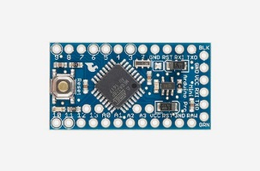
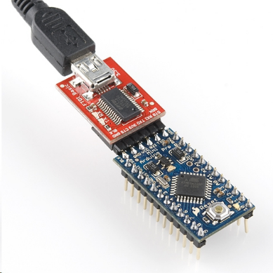
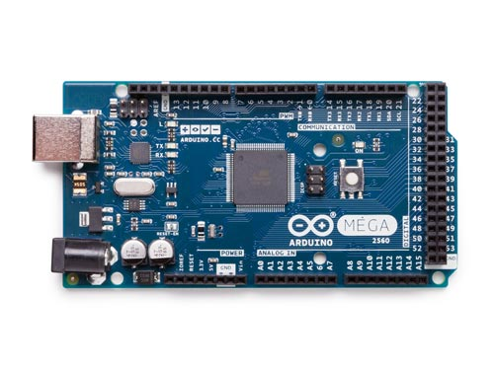
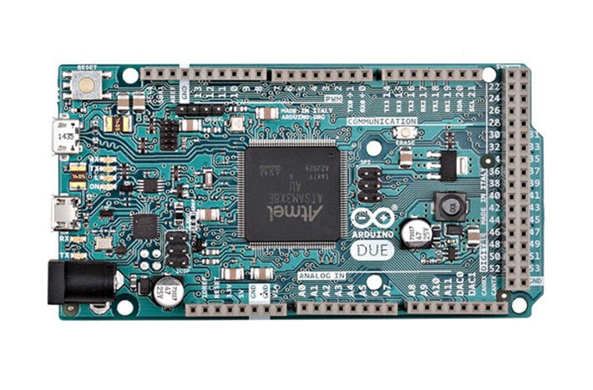
Arduino variants
Pro Mini
8 DIO
2 AD chan (8bit)
1 hard serial
No USB
(for embedded)
smaller
UNO
13 DIO
6 AD chan (8bit)
1 hard serial
larger
DUE
54 DIO
10 AD chan (12bit)
4 hard serial
DAC
3.3V
MEGA
54 DIO
10 AD chan (12bit)
4 hard serial

Slide 8
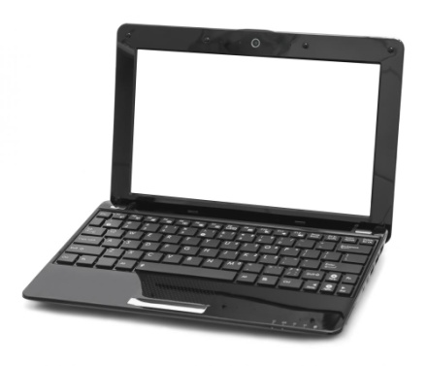
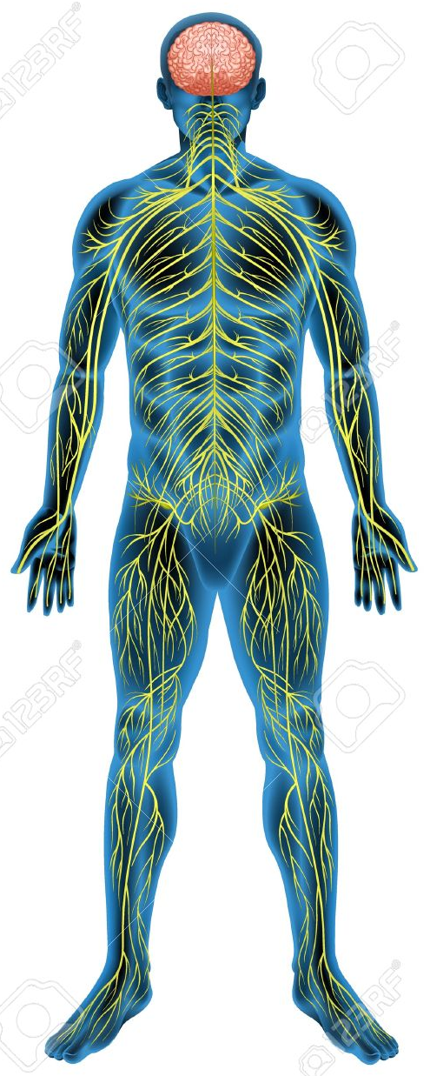

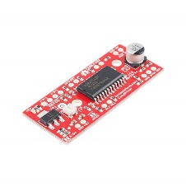
A digital nervous system
PC
Interactive digital systems as metaphor for the nervous system
a “hierarchical control system”
Arduino is like the spinal cord
Inputs and outputs: sensory and motor systems
Rapidly perform “behaviors” given particular inputs
arduino
sensors
motors

Slide 9
Arduino for Neuroscientists: Course objectives
Learn the features and limitations of the Arduino
Learn about a diverse toolbox of electronic sensors and motors.
Write Arduino programs to interact with these devices.
Interface the Arduino with a computer.
Combine these elements to design an interactive multimodal behavioral system.

Slide 10
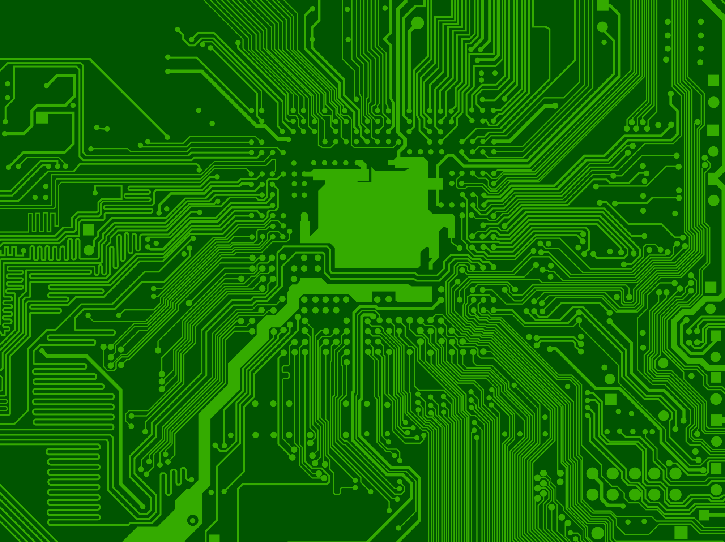
Course overview
AfN #1: Intro, Simple Inputs and Outputs
AfN #2: Advanced Input/Output
AfN #3: Motors, Data logging/computers
AfN #4: Advanced computer interface
AfN #5: Student projects
Notes:
In this course, I want to give a practical, hands-on introduction to basic concepts and practice of Arduino programming and circuit design.

Slide 11
AfN#1: Introduction, Simple Inputs and Outputs, Arduino shields
TODAY:
Anatomy of an Arduino
Input/Output overview
Your first Arduino program: Blink
A simple Digital Output: digitalWrite(pin, STATE);
Digital Inputs
Buttons/levers
digitalRead(pin);
Analog Inputs
Potentiometer input (voltage divider)
analogRead(pin);
Serial plotter
IR beam break detector
OpenMaze shields

Slide 12
Anatomy of an Arduino
An Arduino breaks out the most useful features of the ATMEL microcontroller chip into connectors (headers) that make it easy to interface with electronic circuits (e.g. sensors and motors), and program via USB.
Reset button
Digital input/outputs
Serial RX/TX (receive/transmit)
USB
(to computer)
ATMEL
Microcontroller chip
Ext. power
(if not from USB)
+5V, GND
Analog inputs
Notes:
Explain basic features of Arduino. Few things to point out: USB provides power (+5V), let’s you program the board via the IDE, and can be used to send serial output back to computer. Serial communication allows you to send information (e.g. words, numbers) back and forth from Arduino to computer, or other devices. Analog pins allow you to read electrical signals from sensors/circuits. Digital pins can be used as binary (HIGH/LOW = +5V/GND) inputs or outputs.

Slide 13
Inputs and Outputs: Sensory and Motor Systems
Digital input/output
digitalRead(readPin);
digitalWrite(outPin, HIGH/LOW);
TTL: 0/+5V
Buttons: INPUT_PULLUP
Digital communication protocols
Using Arduino libraries
Serial
I2C, SPI
Analog input (and ~output)
analogRead(readPin);
8bit ADC
analogWrite(PWM pin);

Slide 14
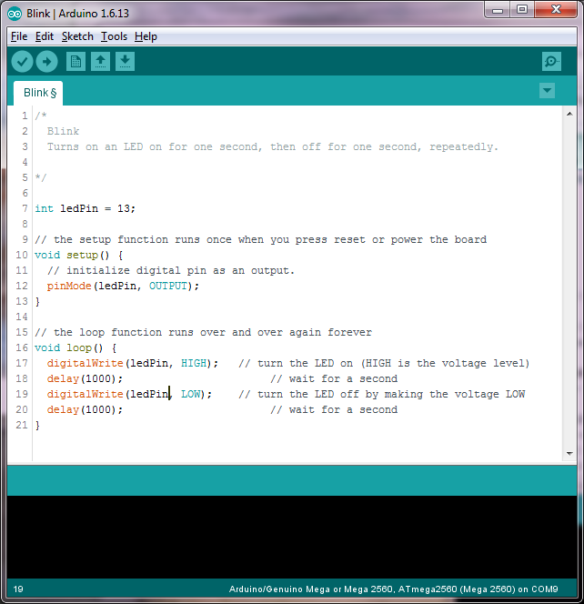
Simple Digital Outputs:
Writing your first Arduino program, “Blink”
1.) write program
Initialize variables
Setup: define states of digital pins, set up other hardware (runs once)
Loop: runs over and over again, checking inputs and sending outputs (delays in ms)

Slide 15
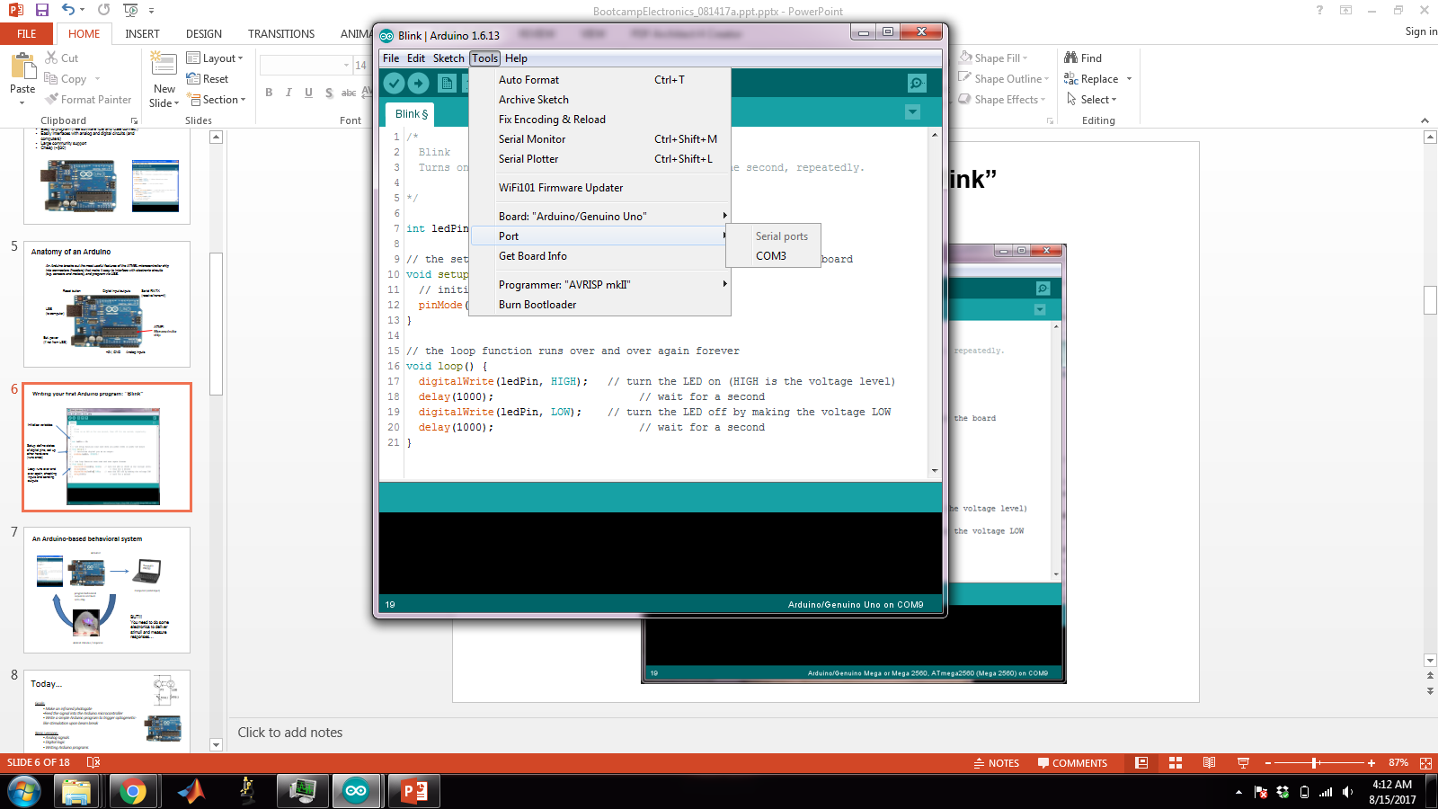
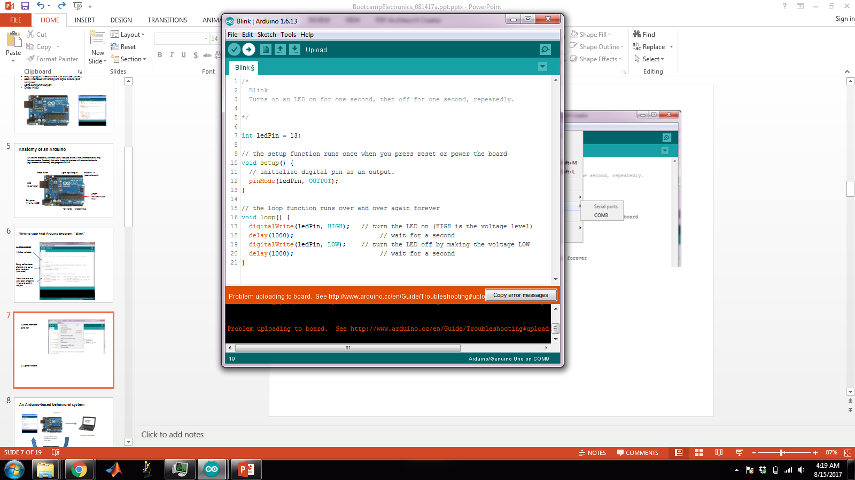
2.) select board and serial port
3.) upload to board
Notes:
As an exercise, change the delays and see how it changes the pattern of flashing.

Slide 16
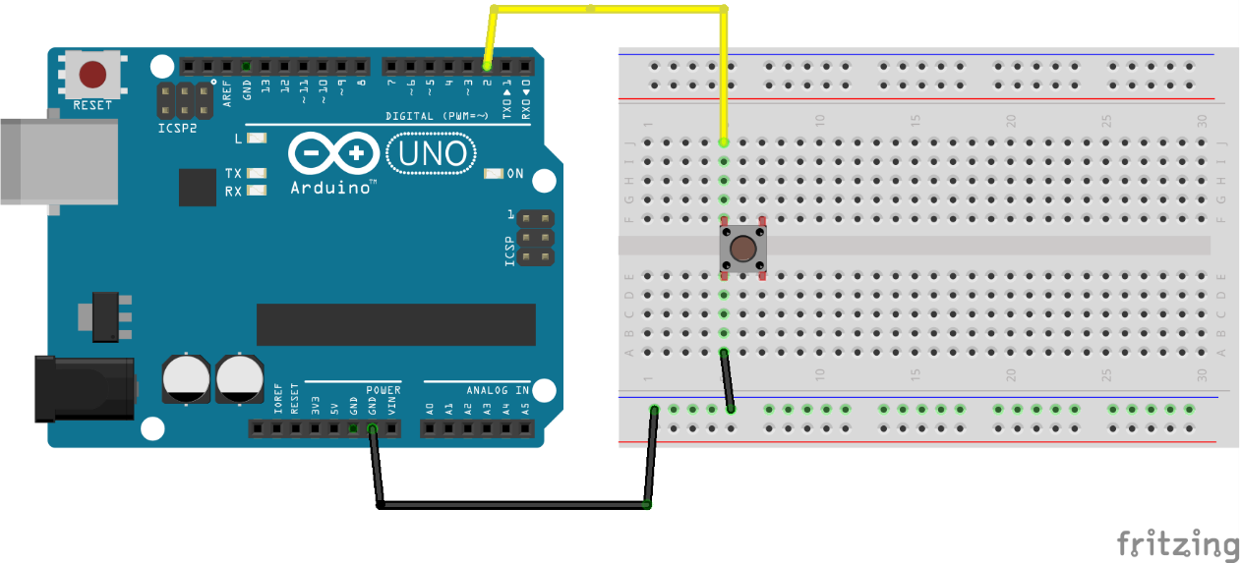
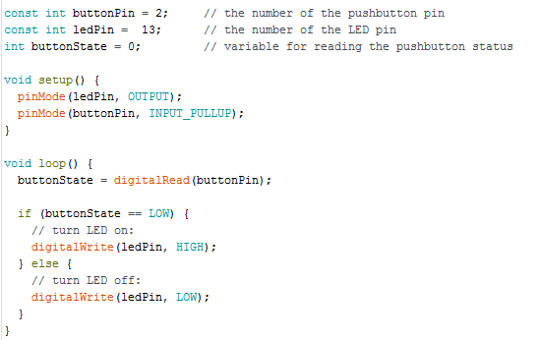
Digital input (with a pushbutton switch)
Breadboard:
Power/GND rails
Circuit
Plug rows
Arduino Code
Notes:
Discuss debouncing, floating inputs

Slide 17
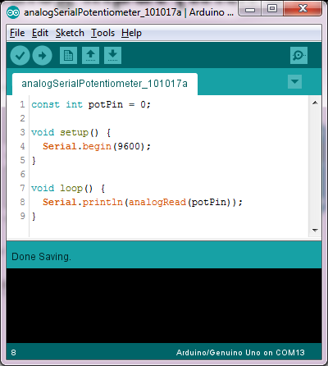
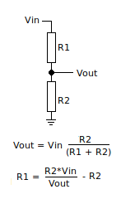
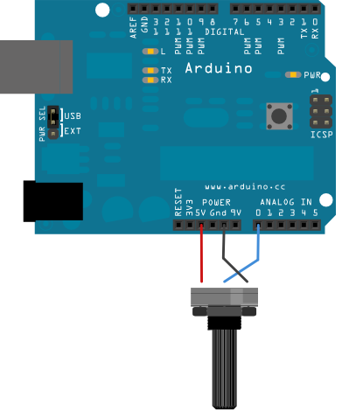
Analog input (with a potentiometer)
(TK: CODE)
Note: you don’t have to use pinMode on analog pins.

Slide 18
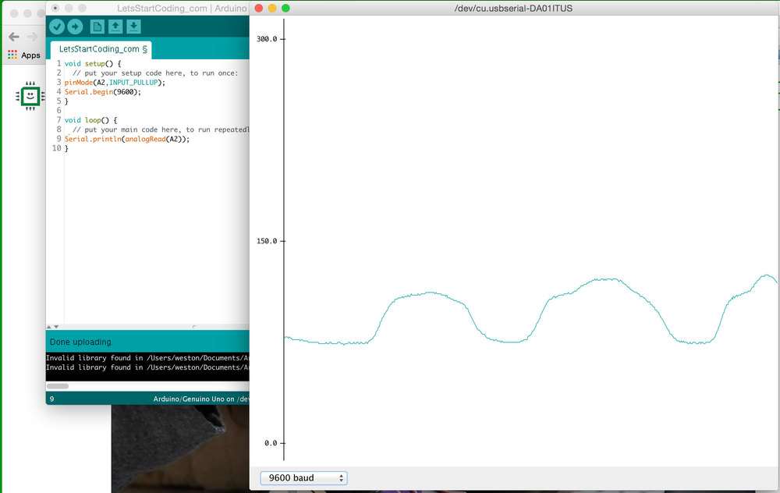
Use serial plotter in the Arduino IDE to visualize potentiometer output via analogRead(A0);

Slide 19
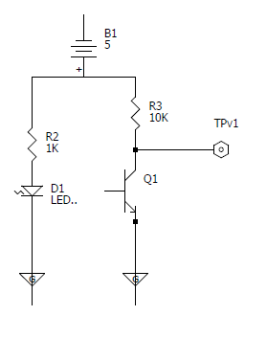
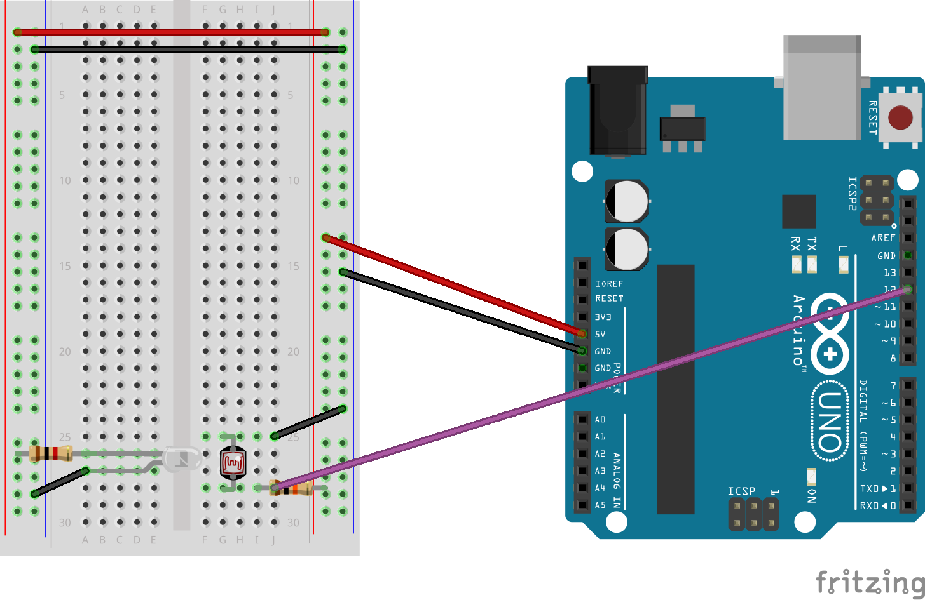
IR photogate/beam-break detector
Vout
X
Vout
(to A0)
IR LED
detector
Notes:
Point out that when beam is unbroken, Q1 phototransistor resistance is low and Vout “hears” GND more than 5V, so voltage is LOW. When beam is broken, Q1 resistance is high and Vout “hears” 5V more, so voltage is HIGH. Use simple Serial.println(analogRead(0)); program and Tools>Serial Plotter to align LED (aligned when value is LOW/0 V ).

Slide 20
Use serial plotter in the Arduino IDE to align LED and set threshold

Slide 21
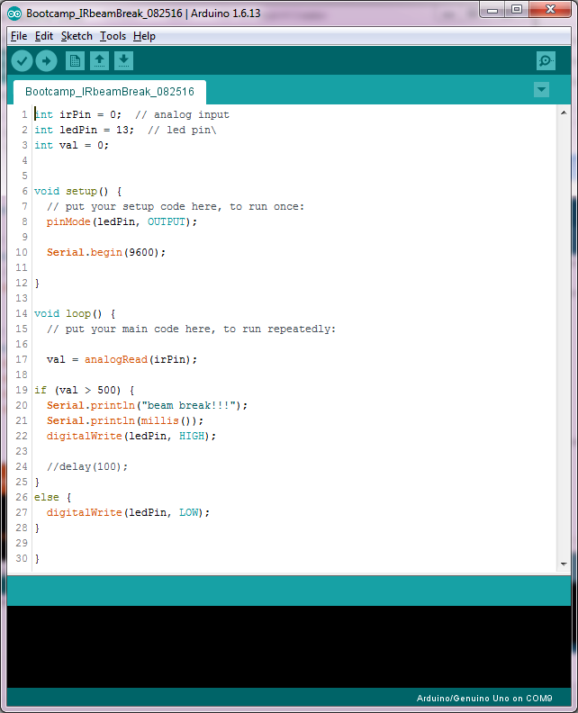
Write and upload program

Slide 22
X
Vout (to A0)
IR LED
detector

Slide 23
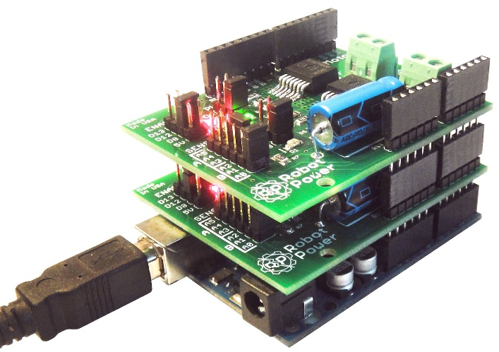
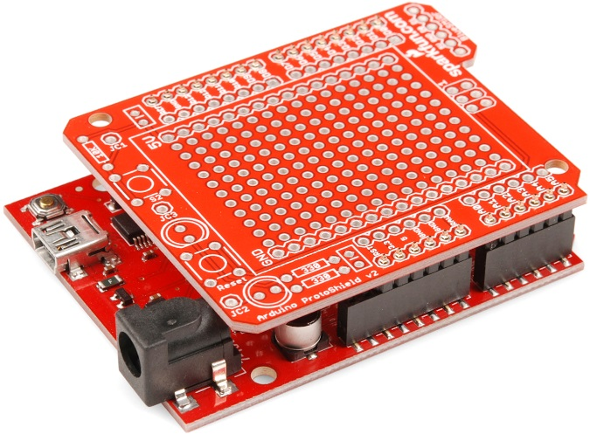
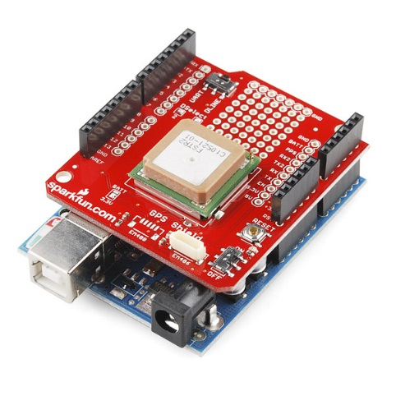
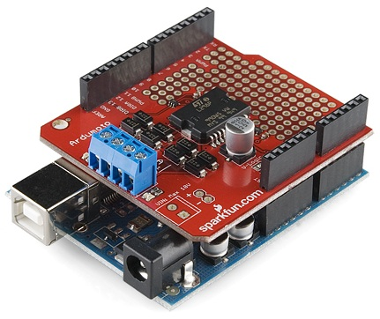
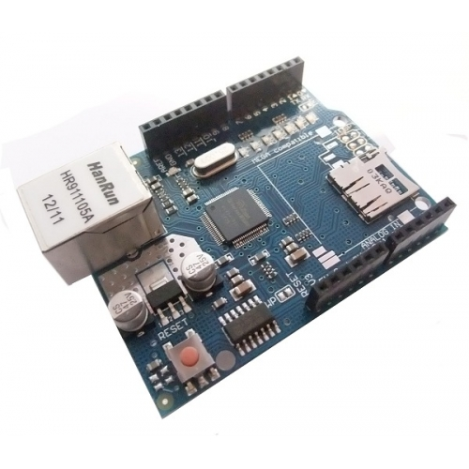
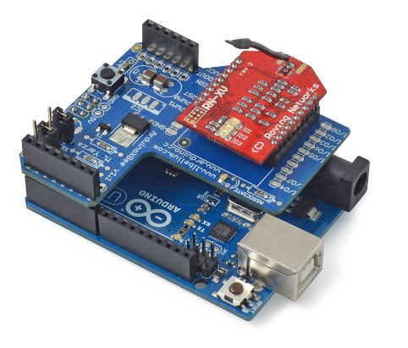
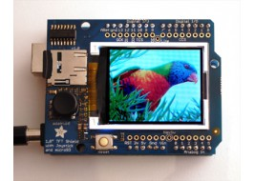
Arduino shields
Allow you to build dedicated circuits for interfacing with arduino

Slide 24
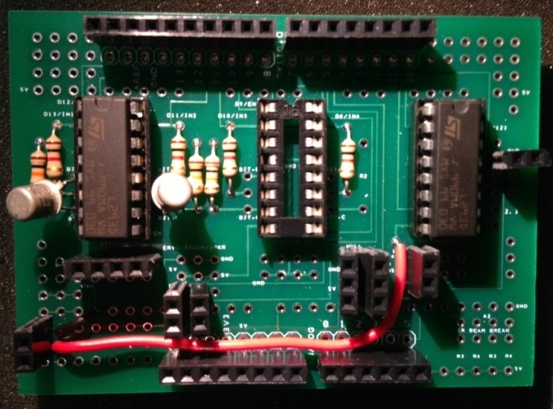
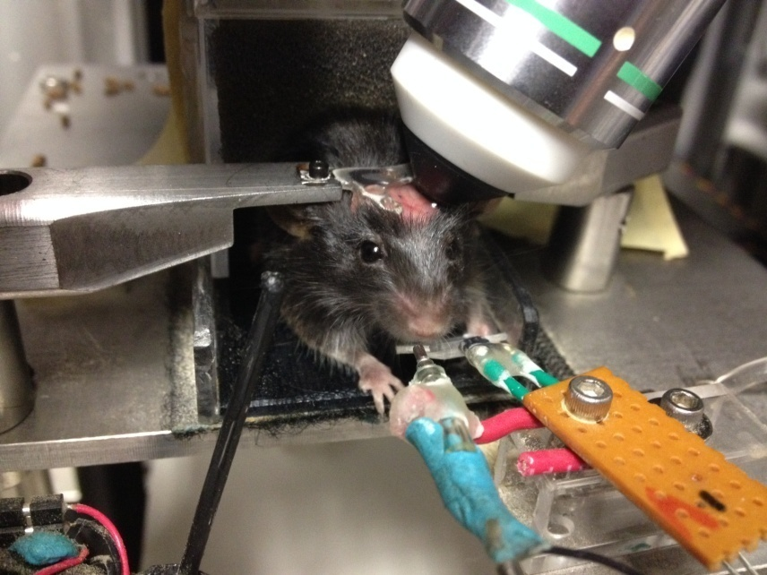
OpenMaze Arduino shields a tool for design of automated behavioral tasks - cheap - flexible - easy to set up
pen
aze
openmaze.org
+
Behavioral system

Slide 25

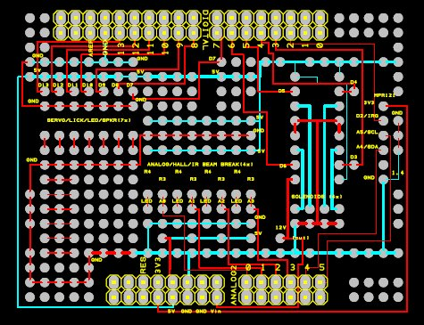
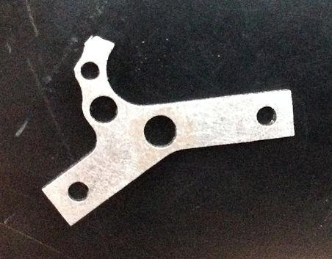
Hardware: 3D printing/laser cutting, PCB designs
Software: example code
The OpenMaze website gives designs and instructions for interfacing with a variety of components useful in animal behavior experiments.

Slide 26
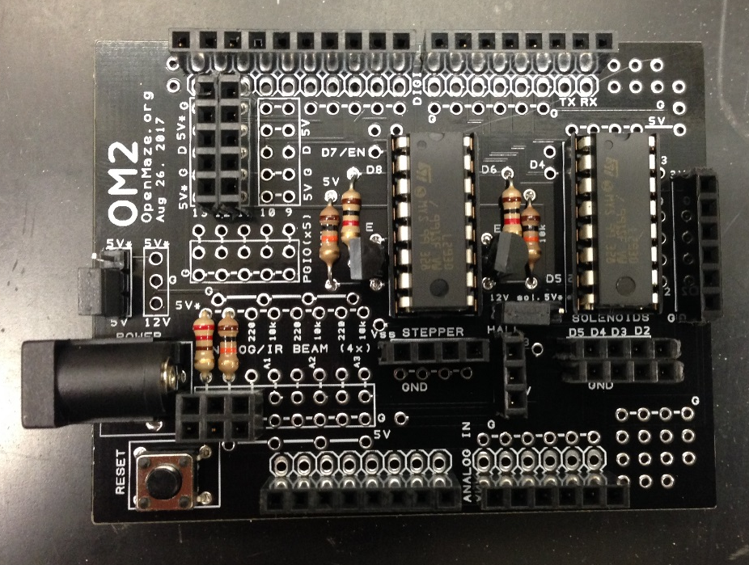
For this class: the OM2 board

Slide 27
OM2 shield
Stepper/DC motor
PGIO ports:
Speaker
Servo
Single touch
LED
MPR121 touch sensor (I2C, x12)
Sol. Valve (12/5V, x4)
IR beam break detector (x4)
Hall effect sensor
Notes:
Using this shield will allow us to try out a wide range of different devices without spending time on wiring.

Slide 28


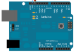
Problem Set #1:
Pavlovian conditioning
Printing times of nosepokes
Programming without using delay();
Using random(); , and creating exponential distributions.

